Slide 1
Inner & Outer JOins

Slide 2
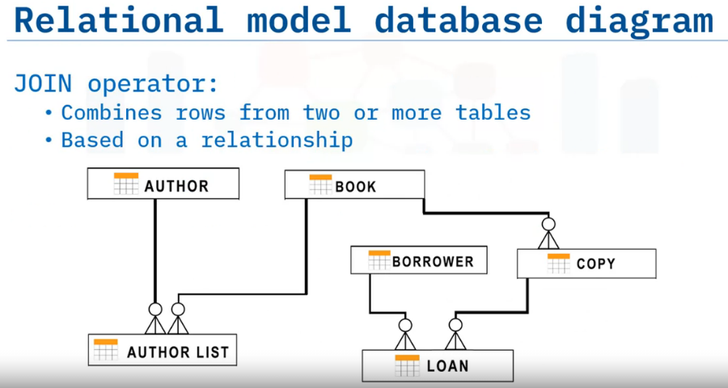
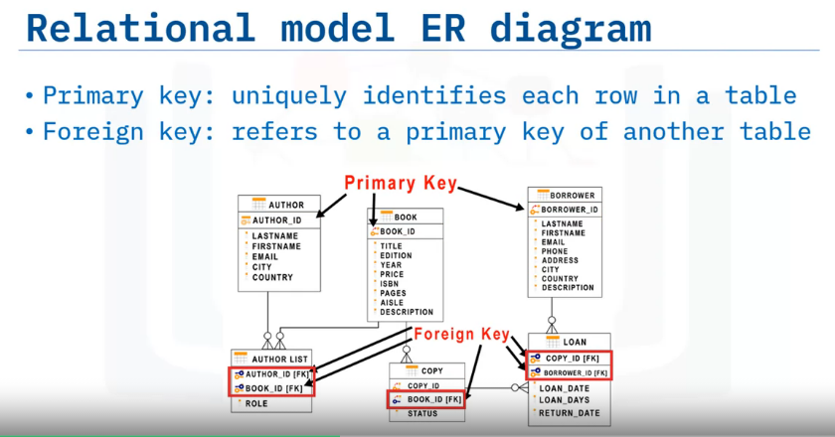
Inner Joins displays only the rows from two tables that have matching value in a common column.
usually the primary key of one table that exists as a foreign key in the second table.

Slide 3
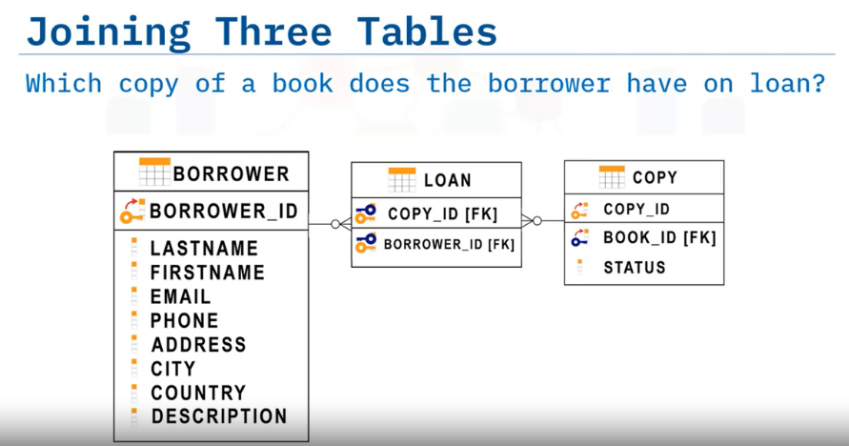
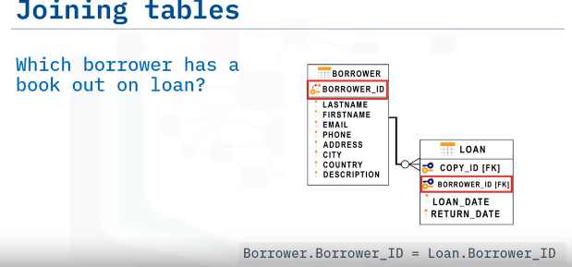
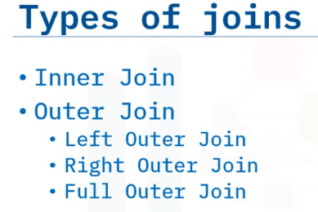
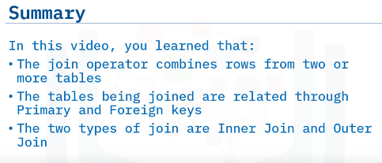

Slide 4
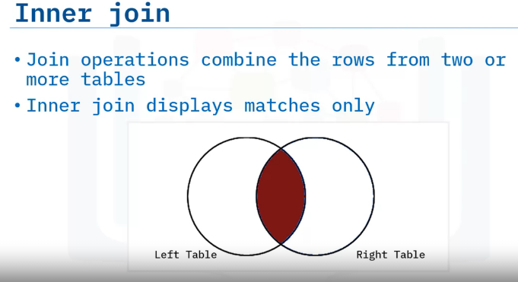
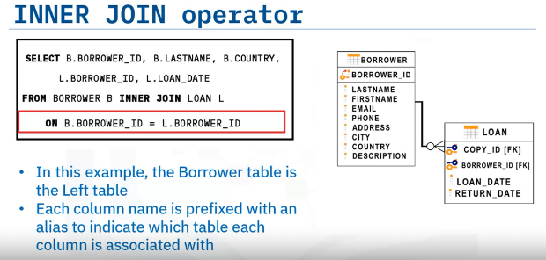

Slide 5
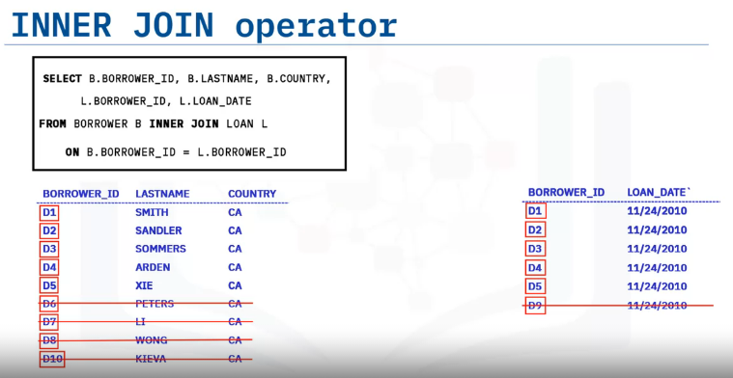
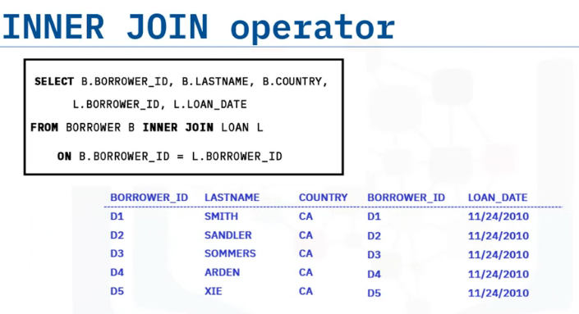

Slide 6
Outer Joins
Left Outer Joins
Right Outer Joins
Full Outer Joins

Slide 7
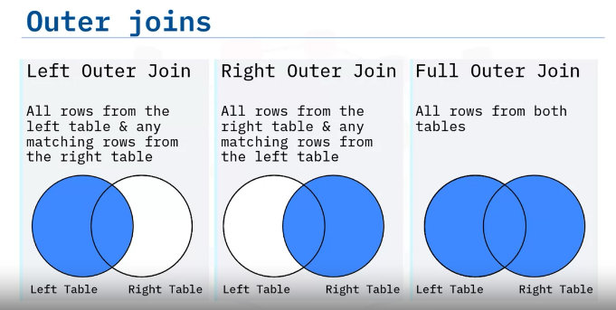

Slide 8
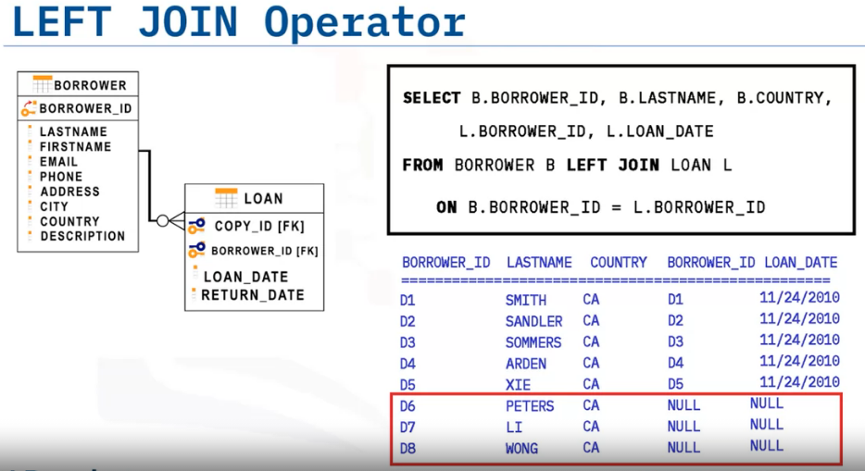
There is no loan date for the last three rows, so the borrower ID and loan date show null values.

Slide 9
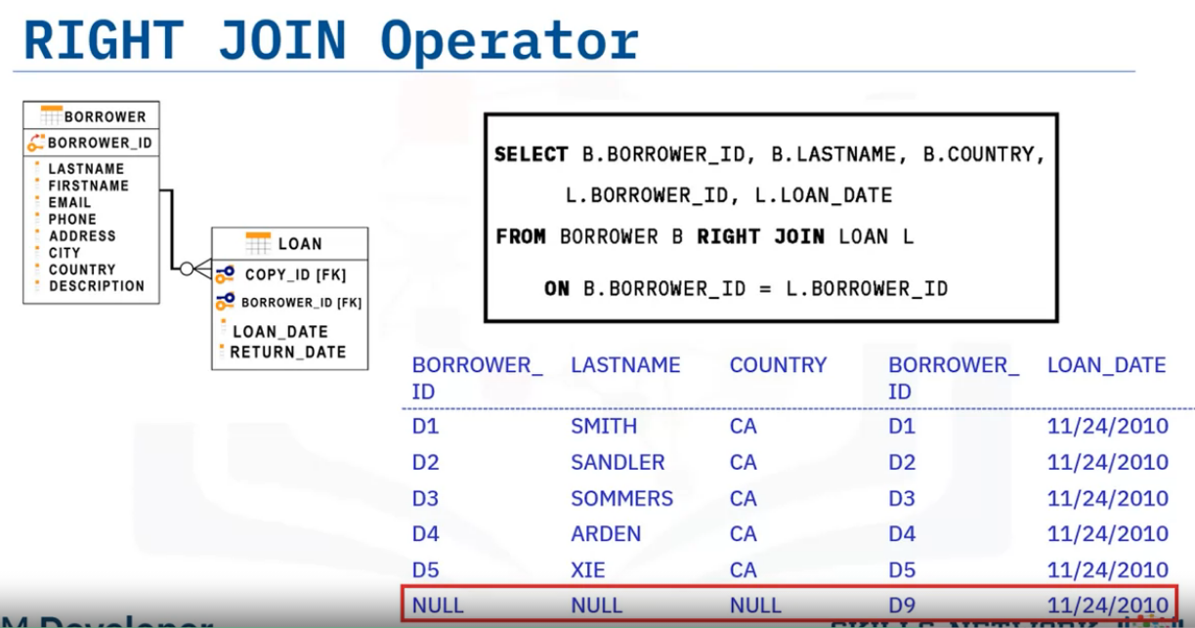
For the last row, there is no matching row in the borrower table, so the Borrower_ID, Lastname, and Country show null values.

Slide 10
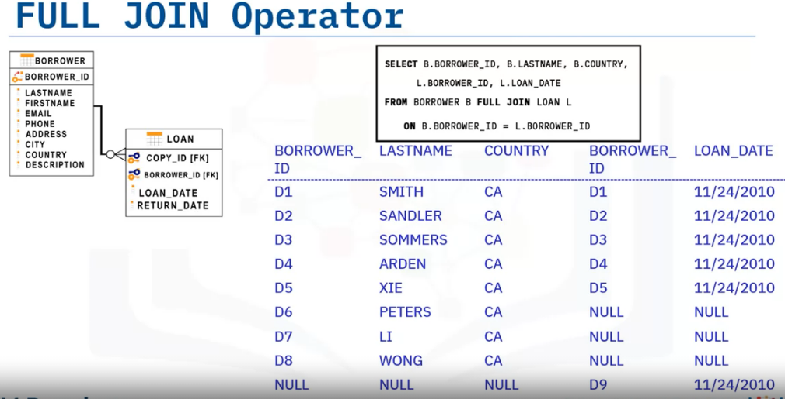

Slide 11
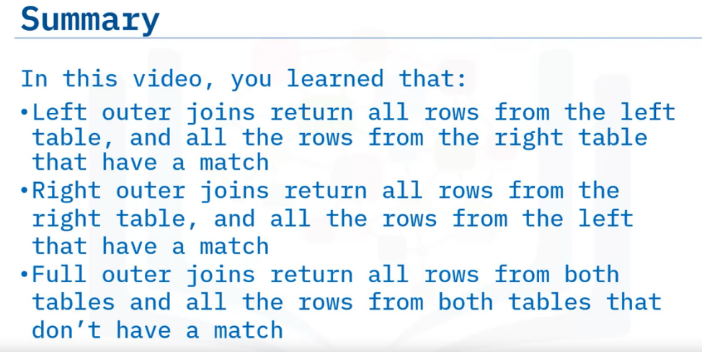
We can use a self-join to compare rows within the same table.

Slide 12
(Practice Hands-on Lab: Joins-DB2) Chicago
Problem1. List the case number, type of crime and community area for all crimes in community area number 18.
SELECT CRD.case_number, CRD.primary_type, CPS.community_area_number,cps.community_area_name FROM CHICAGO_CRIME_DATA AS CRD
INNER JOIN CHICAGO_PUBLIC_SCHOOLS AS CPS ON CRD.community_area_number = CPS.community_area_number WHERE CRD.community_area_number = 18;
Problem 2. List all crimes that took place at a school. Include case number, crime type and community name.
SELECT CRD.LOCATION_DESCRIPTION,CRD.Description,CRD.case_number,crd.primary_type,CCD.community_area_name FROM
CHICAGO_CRIME_DATA AS CRD LEFT OUTER JOIN CHICAGO_CENSUS_DATA AS CCD ON CCD.community_area_number=CRD.community_area_number
Problem 3. For the communities of Oakland, Armour Square, Edgewater and CHICAGO list the associated community_area_numbers and the case_numbers.

